Slide 1
Visual Learning Tools in Elementary Education
Evaluating Infographics as a Pedagogical Strategy in Science
Group Members: Mehreen Jamshed, Mehwish Saleem, Sadaf Nawaz, Mehreen Pervaiz
Course: School and Classroom Management
Course Instructor: Dr. Shumaila Mahmood
Course Code: EDUC3163

Slide 2
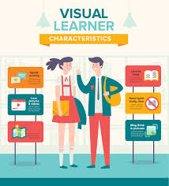
Project Introduction
Objective: Improve science learning in an underprivileged school through visual learning tools.
Approach: Replace traditional oral lectures with infographics for better concept clarity.

Slide 3


Tools Used
Canva: Used for designing colorful, child-friendly infographics.
Mapify: Used for adding interactive elements to visuals.

Slide 4

Topics Selected
Ecosystem
States of Matter
Force and Motion
Human Health
Plant System

Slide 5
Fieldwork at School
Visited underprivileged school
Taught Grade 4 students using self-created infographics
Made sessions interactive and participatory

Slide 6
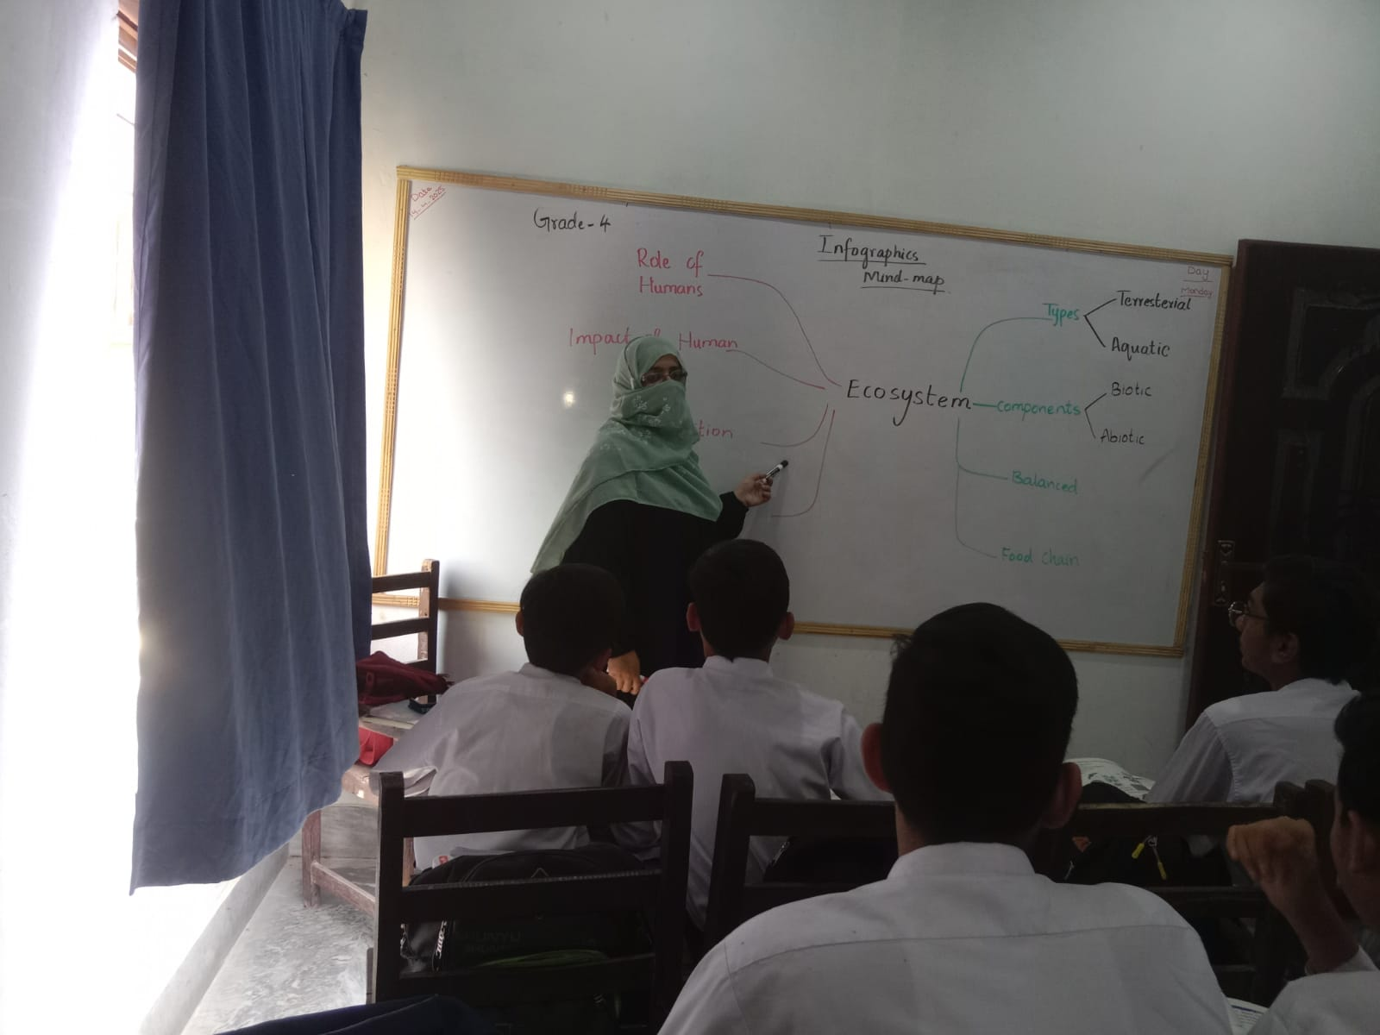
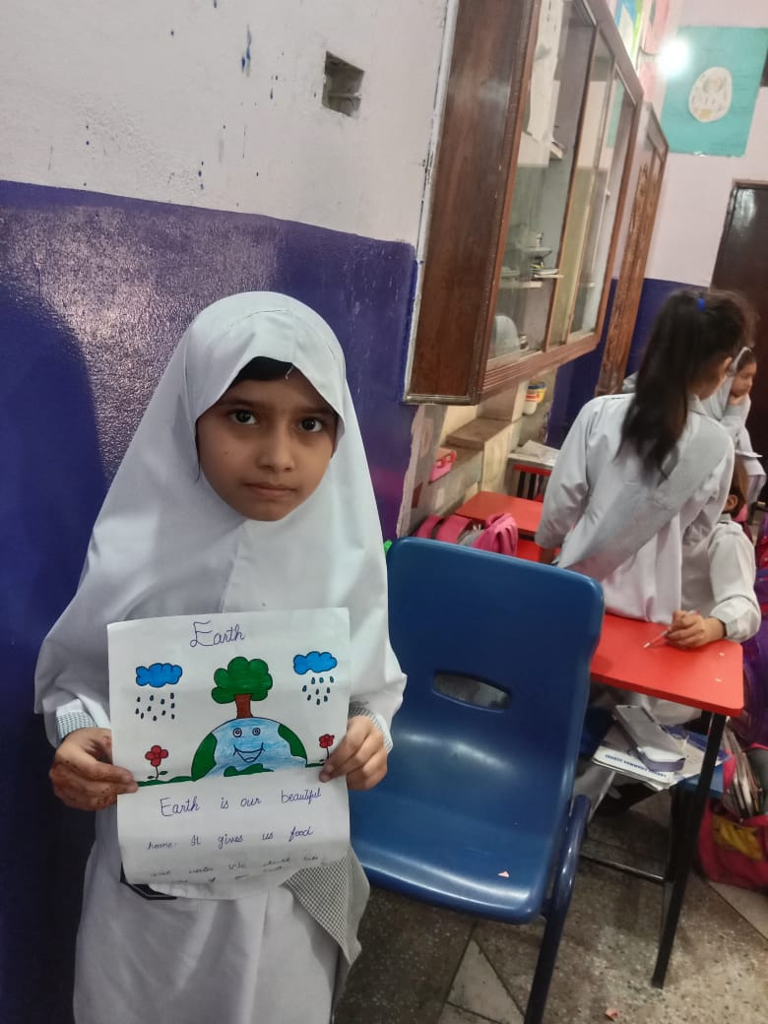
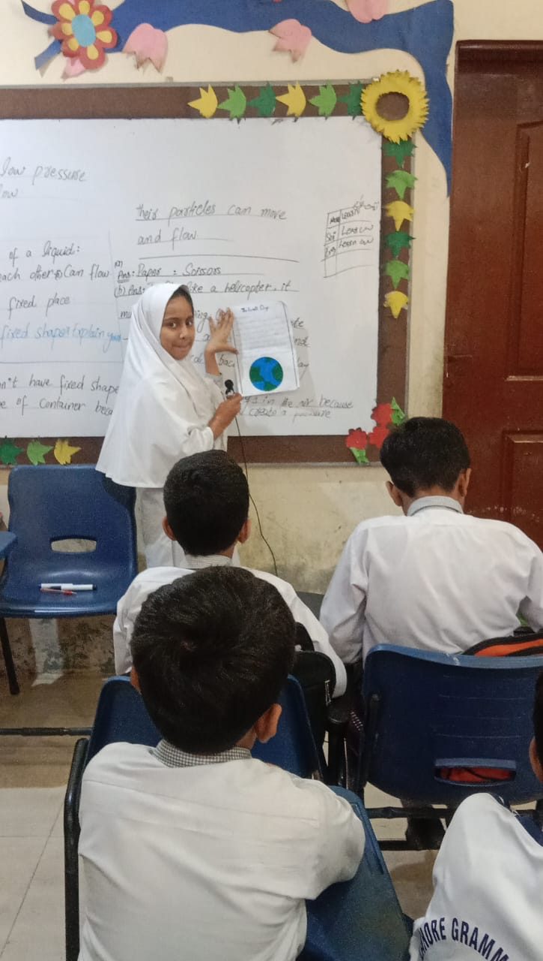
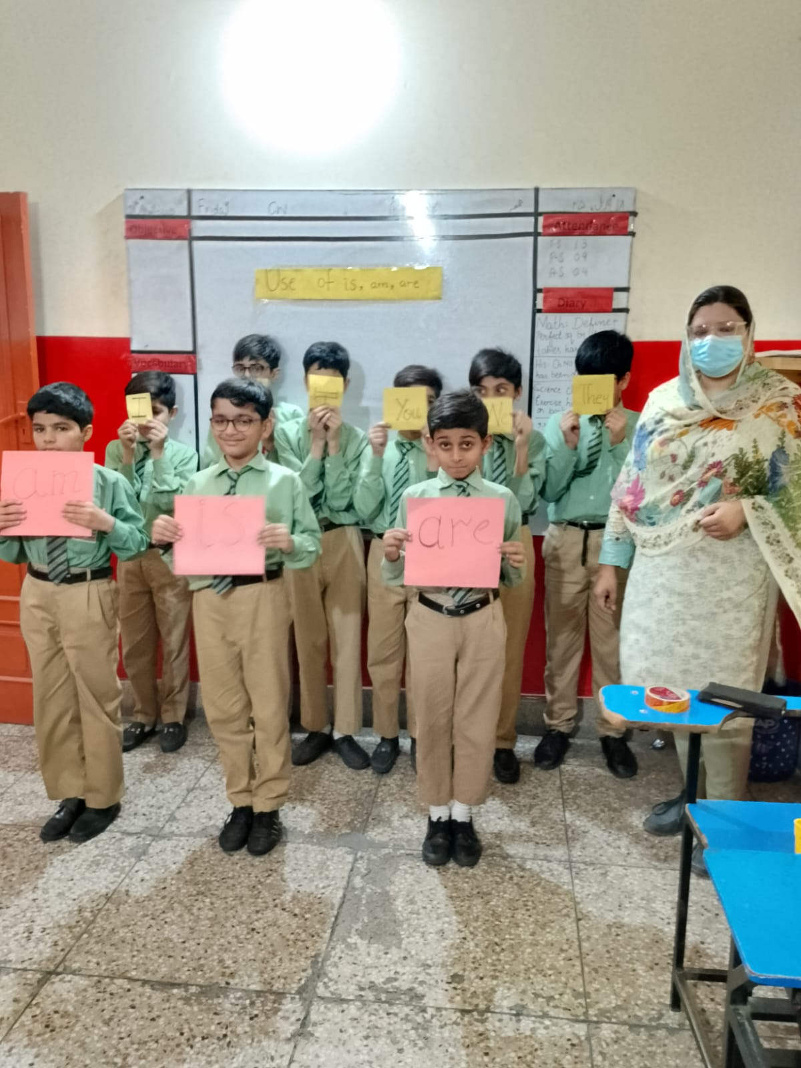
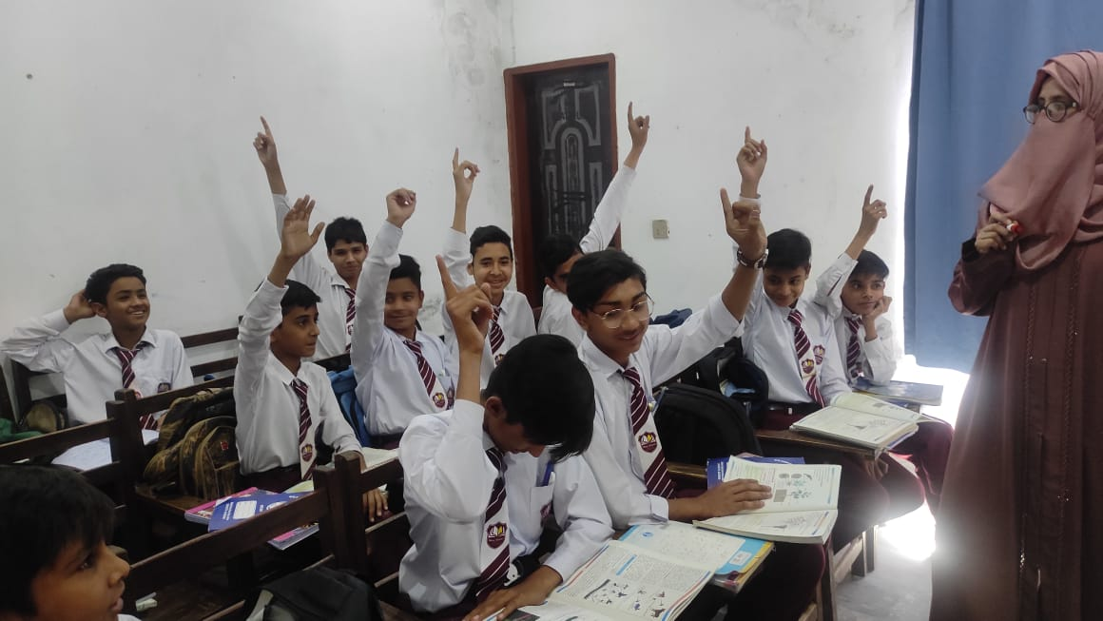

Slide 7
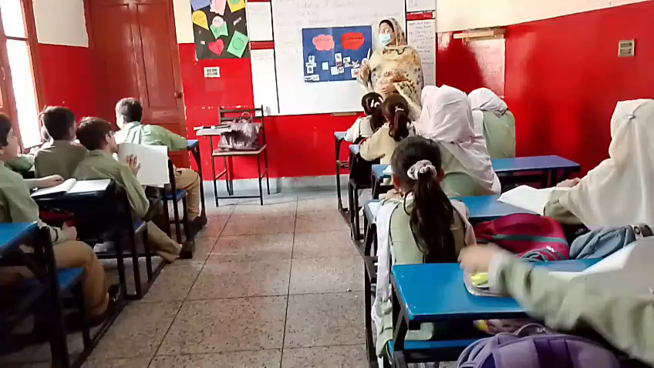

Slide 8
Student Feedback
Students found the infographics easier to understand than oral lectures.
Comments:
"Topics are very clear",
"Learning is fun with pictures!"
Increased engagement and interest.

Slide 9
Impact and Learning
Visual tools significantly improved understanding.
Enhanced student engagement.
Developed our teamwork, communication, project management, and creative skills.

Slide 10
Team Collaboration
Each member:
Selected a science topic
Designed an infographic
Visited the school and taught students
Took direct feedback from students
Seamless coordination and balanced participation.

Slide 11
Conclusion
Visual strategies, like infographics, enhance classroom learning.
Should be integrated widely, especially in resource-limited schools.
Thank you!

Slide 12

Any Questions?

